Slide 1
Data Harmonization and Insights Extraction
Name : Sukriti Singh Choudhary
Subtitle : NextHikes IT Solutions Project - 2
Date of Submission : 14th,January 2025

Slide 2
Project Overview
The project focuses on data harmonization and insights extraction from 3 Datasets datasets related to ride rentals of Bikes. The primary objective is to address inconsistencies and ambiguities in the data, ultimately creating a clean, unified dataset for further analysis.
Phase 1: Data Acquisition
On initial stage we have to do data inspection reveals potential issues with missing values and data types, which are crucial for ensuring accurate analyses. For that I used given tools
Pandas for data manipulation.
NumPy for numerical computations.

Slide 3
Merge the datasets: Using the common key instant.
Handle missing values: Apply imputation techniques.
Perform statistical analysis: Evaluate mean, median, and mode.
Clean data: Remove duplicates and unnecessary columns.
The merged dataset has 610 rows and 17 columns. There are missing values in the atemp column, with 11 entries missing. Identify and remove duplicates and unnecessary columns (Unnamed: 0).
Dataset after Cleaning:
Shape: 610 rows and 16 columns.
The column Unnamed: 0 has been removed, and duplicates were handled.
Statistical Analysis:
Key metrics (mean, median, standard deviation, and mode) have been calculated for numerical columns:
Example: temp: Mean = 0.197, cnt (total count): Mean = 55.57,

Slide 4
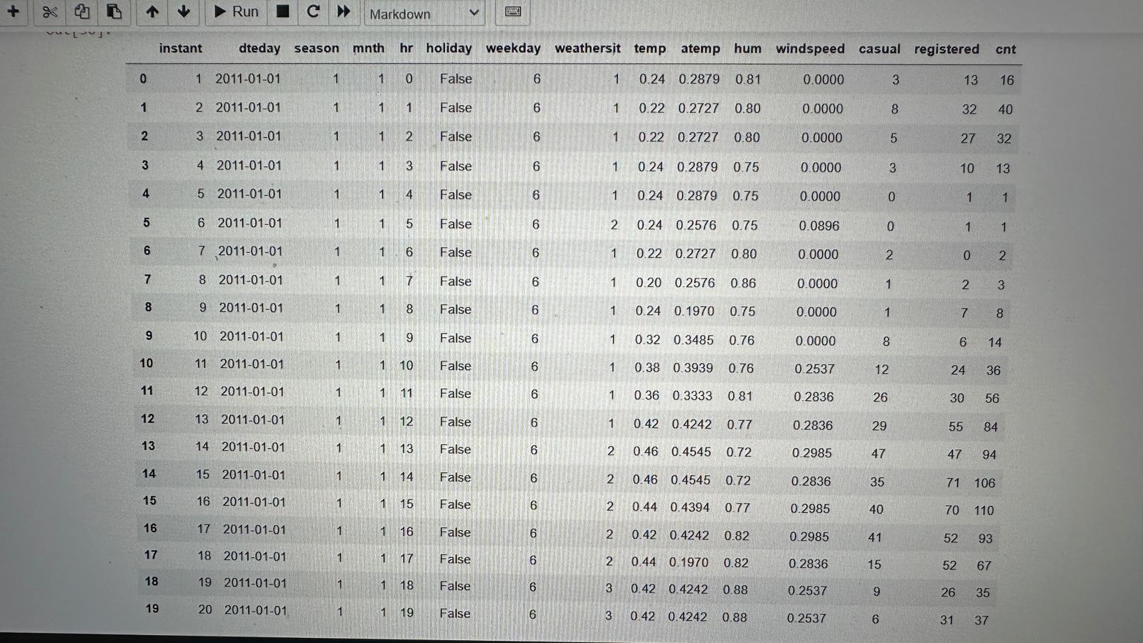
After inspecting the dataset, document your initial observations regarding data quality and completeness. Consider the following aspects:
Data Types: Are they appropriate for each column or not? For instance, dates should be in datetime format.
Missing Values: Check for any columns with missing values.
This given image of after merging dataset_1 & dataset_2 where everything is clear

Slide 5
Phase 2: Data Wrangling
By following these steps, you will have successfully integrated Dataset_1 and Dataset_2, handled missing values appropriately, performed basic statistical analysis to evaluate central tendencies, and cleaned the dataset by dropping unnecessary columns and duplicates. This prepares your data for further analysis or modeling tasks.
Improved Data Integrity: Merging datasets enhances the overall quality by providing a fuller picture of ride rentals.
Imputation Effectiveness: Properly handling missing values minimizes bias in analyses, leading to more reliable insights.
Confirm that the data conforms to expected formats for each column (e.g., date formats, numerical ranges).
Type Checking: Ensure that each column has the correct data type ( integers for counts, floats for temperatures).
Consistency Checks: Verify that values fall within logical ranges (temperature should not be below absolute zero).
Identify Missing Data: Use functions like .isnull() in Pandas to detect missing values.
Median Imputation: Replace missing values with the median of the column

Slide 6
Integration of Dataset_3 or Concatenation of Dataset_3 to the merged dataset
Integrating Dataset_3 allows for a more comprehensive view of ride rental patterns, enriching the dataset with additional variables such as weather conditions and user types
Missing values can significantly impact the integrity of analyses. For instance, if key variables like temperature or humidity are frequently missing, it may skew results related to rental counts.
: Identifying outliers is critical as they can disproportionately influence statistical analyses and model performance and also understanding this concept reinforces the need for careful outlier detection and handling.
After all this now we do Capping based on statistical thresholds (IQR) help to maintain the dataset's integrity while reducing the potential distortion caused by extreme values.

Slide 7
Phase 3: Data Analysis
Analyzing Skewness of Numerical Columns
Assessing the skewness of numerical columns helps identify the distribution shape of data. If the count of rentals is positively skewed, it indicates that most rental counts are low, with a few high outliers.
Application of Transformations: If significant skewness is detected , transformations such as log or square root can be applied to normalize the data, making it more suitable for statistical analysis and modeling. This normalization can enhance the performance of algorithms that assume normally distributed data.
2. Computing Correlations Between Attributes
Calculating correlation coefficients between attributes such as temp, humidity, and count reveals relationships that can inform business strategies. For example, a strong positive correlation between temperature and rental counts may suggest that warmer weather drives higher rental activity.
Identifying Relationships: Understanding these relationships allows for targeted marketing strategies, such as promoting rentals during favorable weather conditions or holidays when rental counts are expected to increase.

Slide 8
3. Visualizing Key Insights Using Heatmaps, Scatter Plots, and Boxplots
Heatmaps: Visualizing correlations using heatmaps provides an intuitive overview of relationships between multiple variables at once. This can highlight not only strong correlations but also unexpected relationships that warrant further investigation.
Scatter Plots: Scatter plots can illustrate the relationship between two continuous variables, such as temp and count. They can reveal trends, clusters, or outliers visually. For instance, a scatter plot may show that as temperature increases, rental counts also tend to rise, but with some notable exceptions (outliers).
Boxplots: Boxplots are effective for visualizing the distribution of rental counts across different categorical variables like season or weather. They can highlight variations in rental behavior across seasons, indicating which times of year are most popular for rentals.
So given bellow Box Plot image here we deduct some outliers and now we are going to handle these outliers using capping method based on IQR.
1 - weathersit: 1 outlier, 2 - temp: 66 outliers, 3 - atemp: 41 outliers, 4 - windspeed: 4 outliers, 5 - casual: 66 outliers, 6 - registered: 45 outliers, 7 - cnt: 30 outliers,

Slide 9
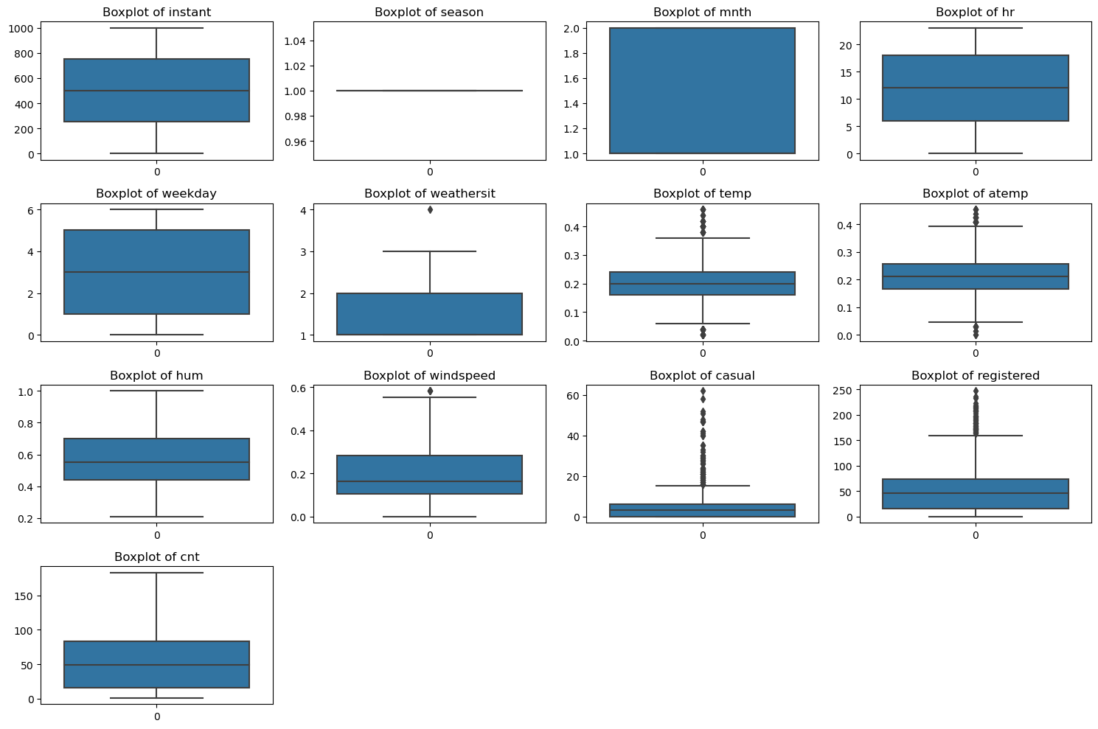
Box Plot

Slide 10
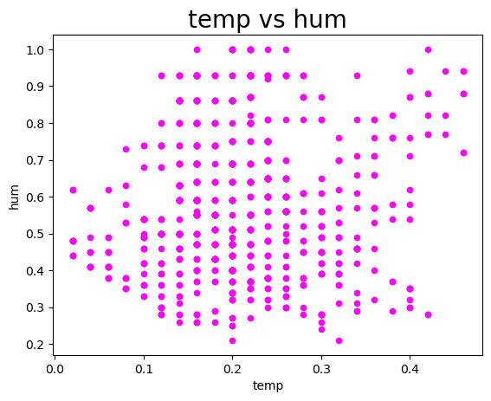
Scatter Plot
There might be a trend where humidity decreases as temperature increases. Warmer air can hold more moisture, but relative humidity tends to drop as the temperature rises. Observe if there are distinct clusters in the data. High humidity at low temperatures might indicate cooler, wetter conditions (like early mornings or rainy days). Low humidity at higher temperatures could suggest hot and dry Humidity levels between 30-60% might align with moderate temperatures, showing a region where the weather is perceived as comfortable. These insights can help understand the interplay between temperature and humidity, which is useful in weather analysis, planning outdoor events, or predicting demand in weather-sensitive industries.

Slide 11
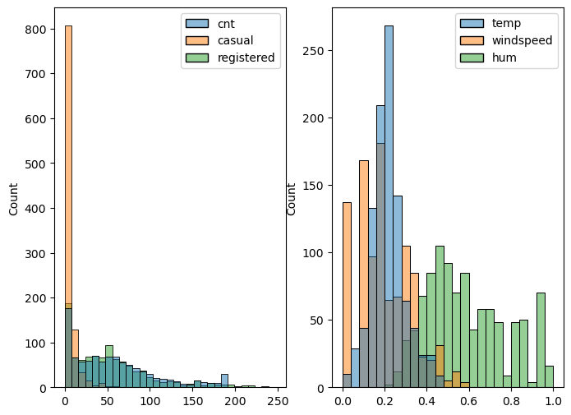
The provided code generates two subplots with histograms, displaying the distribution of variables from a dataset named final_data. Here's an analysis of the possible insights based on the visualizations it creates: Plot 1: Distribution of 'cnt', 'casual', and 'registered' (on ax1) This plot represents the distribution of three variables Plot 2: Distribution of 'temp', 'windspeed', and 'hum' (on ax2) This plot shows the distribution of three weather-related variables The relationship between bike rentals and weather conditions can be analyzed from this.

Slide 12
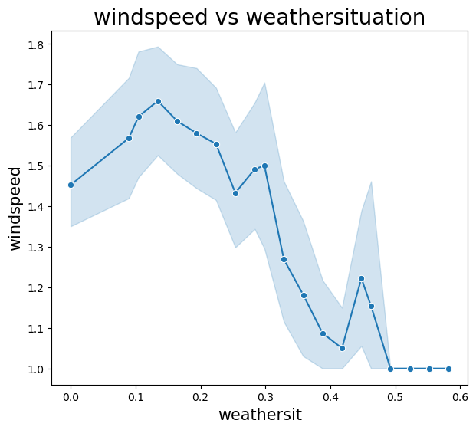
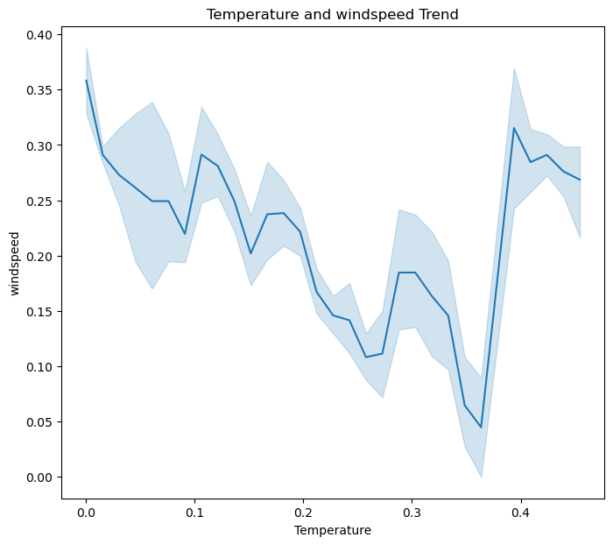
Line Plot
Inverse Relationship:
You might notice that as windspeed increases, weathersit tends to decrease. This reflects the cooling effect of wind, where even on warm days, higher winds can make the temperature feel cooler. Periodic Patterns: If the data spans multiple days or seasons, you may observe repeating patterns where windspeed peaks coincide with dips in weathersit, possibly indicating specific weather conditions .Sudden Variations: Sudden spikes in windspeed with corresponding drops in weathersit could indicate events like windy or stormy days. Plateaus in Windspeed: Periods of stable, low windspeed might show a steady or rising trend in weathersit, especially during calm, warm weather. Correlation:

Slide 13
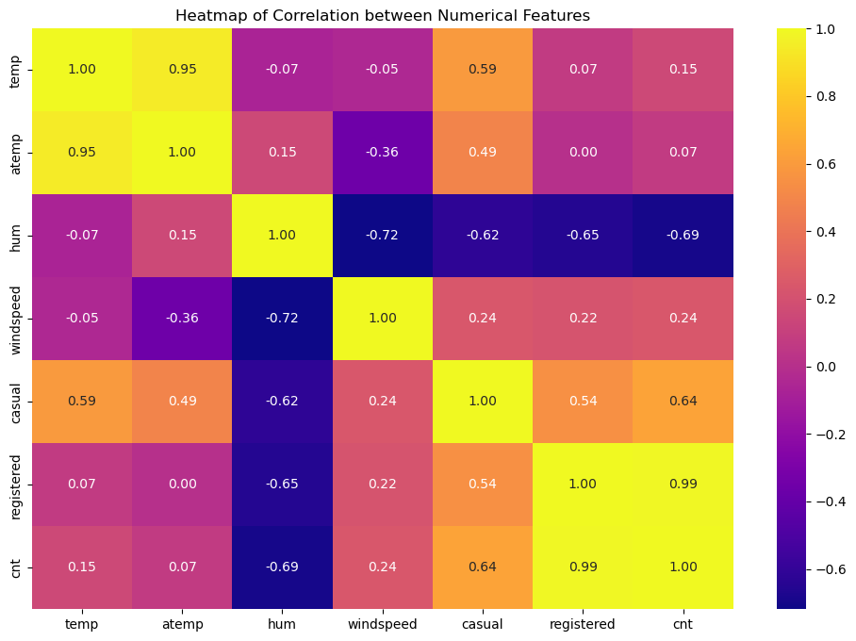
Heatmap
The heatmap helps visualize the correlation between numerical variables in the dataset. Here’s how to interpret and summarize insights from the heatmap based on the dataset:
cnt vs registred: High correlation (close to 1), indicating that the majority of bike rentals are made by registered users. temp vs atemp: Almost perfect correlation (close to 1), as both variables measure temperature but represent actual and perceived temperatures. cnt vs temp/atemp: Positive correlation suggests that bike rentals increase with higher temperatures (people prefer biking in warm weather).

Slide 14
Conclusion
The advanced statistical analysis phase is crucial for extracting meaningful insights from the dataset. By analyzing skewness and applying transformations where necessary, we ensure that our data meets the assumptions required for robust statistical analyses. Correlation computations provide valuable insights into relationships between variables, guiding decisions and strategies. Finally, visualizations such as heatmaps, scatter plots, and boxplots, lineplot and histplot enhance our understanding of data distributions and relationships, making complex patterns more accessible for stakeholders. Collectively, these insights contribute to a deeper understanding of ride rental dynamics and inform future business strategies.

Slide 15
Thank You

